Slide 1

Advancing Competency-Based Clinical Training through Electronic Logbooks: An Implementation Science Approach Using CFIR at KMTC

Slide 2

Introduction
Clinical training is the cornerstone of health professional education

Slide 3

Logbooks are essential tools for clinical training
Monitoring student performance and skills acquisition.

Slide 4
KMTC, clinical medicine students use physical logbooks
Challenges→ clinical learning, supervision, and evaluation
The first phase of this study evaluated students perception and readiness
KMTC diploma clinical medicine students’ experiences with physical logbooks and their their perceptions regarding transitioning to an e-logbook was explored.

Slide 5
Methodology
Baseline study
An exploratory, descriptive, cross-sectional design
Data was collected via electronic questionnaires from 255 clinical medicine students across various KMTC campuses.

Slide 6
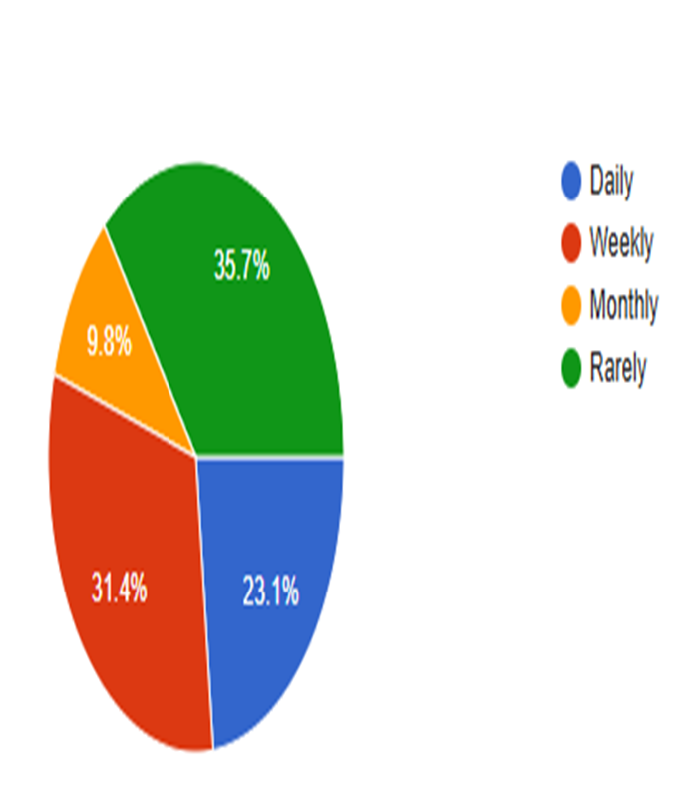
Results
Use and satisfaction
Physical logbooks not optimally utilized in the clinical area
Varying levels of satisfaction that increased with the level of study
Percentage of students who answered the question, “How frequently do you use your logbook?”

Slide 7

Challenges with the Physical Logbook
Risk of loss or damage
“Misplaced one and I'm yet to find it; Gets lost, tearing off, gets wet,”

Slide 8
Challenges with the Physical Logbook
Delayed feedback
“Difficulties in finding mentors to sign log books”
Printing errors
“Some pages are missing”
“The log books were insufficient hence I lacked one”
“Tiresome moving around with, let KMTC embrace technology”

Slide 9
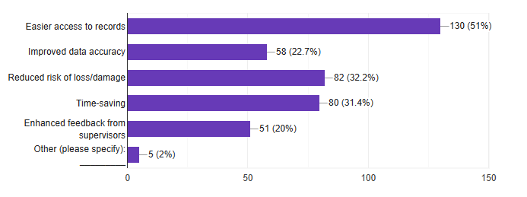
Perceived benefits
E- Logbooks perceived as a more efficient alternative by 70.6% of the students
Students’ response to the question, “What benefits do you anticipate from using an e-logbook?”

Slide 10
Challenges Anticipated with an e-Logbook System
Internet connectivity issues (68.9%)
Technical difficulties with devices (23.6%)
Lack of training on usage (19.3%)
Security and data privacy concerns (13%)
Resistance to change from students or faculty (13%)

Slide 11
Device Accessibility and Readiness for Transition
90.2% have regular access to a smartphone, tablet, or computer for logging entries
89.8% of students believe that integrating an e-logbook system is important in their training

Slide 12

89% recommend the transition to an e-logbook system.

Slide 13
Conclusion
Integrating e-logbooks is feasible and beneficial
Significant enhancement of clinical training and learning experiences for clinical medicine students.
The transition to e-logbooks aligns with KMTC’s strategic plan and Kenya’s Digital Transformation Agenda
Phase 2: Pilot implementation

Slide 14


Slide 15
REFERENCES
Mooney C, Mangaoang D, O’Flynn E, Bekele A, Tierney S, Borgstein E. A thematic review of the use of electronic logbooks for surgical assessment in sub-Saharan Africa. Surgeon. (2021) 20:57–60. doi: 10.1016/j.surge.2021.10.002
Oxyandi, M., Panduragan, S. L., Said, F. M., & Saputra, M. A. S. (2023). Use of Electronic Logbook Based on Mobile Learning in Clinical Learning among Nursing Students. American Journal of Medical Science and Innovation, 2(2), 180–184. https://doi.org/10.54536/ajmsi.v2i2.2095
Paydar, Somayeh & Esmaeeli, Erfan & Ameri, Fatemeh & Sabahi, Azam & Meraji, Marzieh. (2023). Investigating the advantages and disadvantages of electronic logbooks for education goals promotion in medical sciences students: A systematic review. Health Science Reports. 6. 10.1002/hsr2.1776.

